Slide 1


Gamification

Slide 2
Global Game Revenue
The biggest Entertainment and IT industry ever!
Serious Games (US$ 70bn)
A serious game or applied game is a game designed for a primary purpose other than pure
entertainment.
Entertainment (US$ 130bn)
Defence, Health Care, Marketing, Advertising, Sustainability…

Slide 3
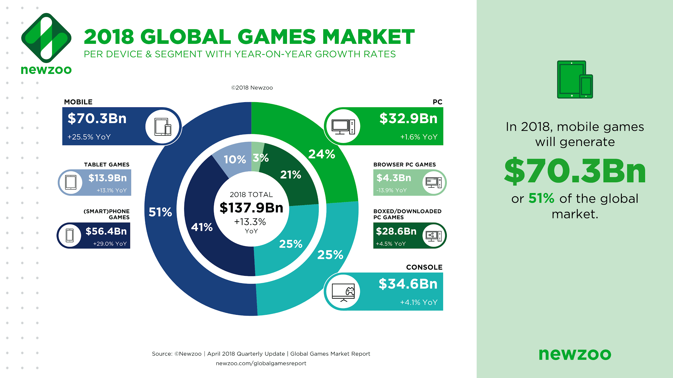

Slide 4
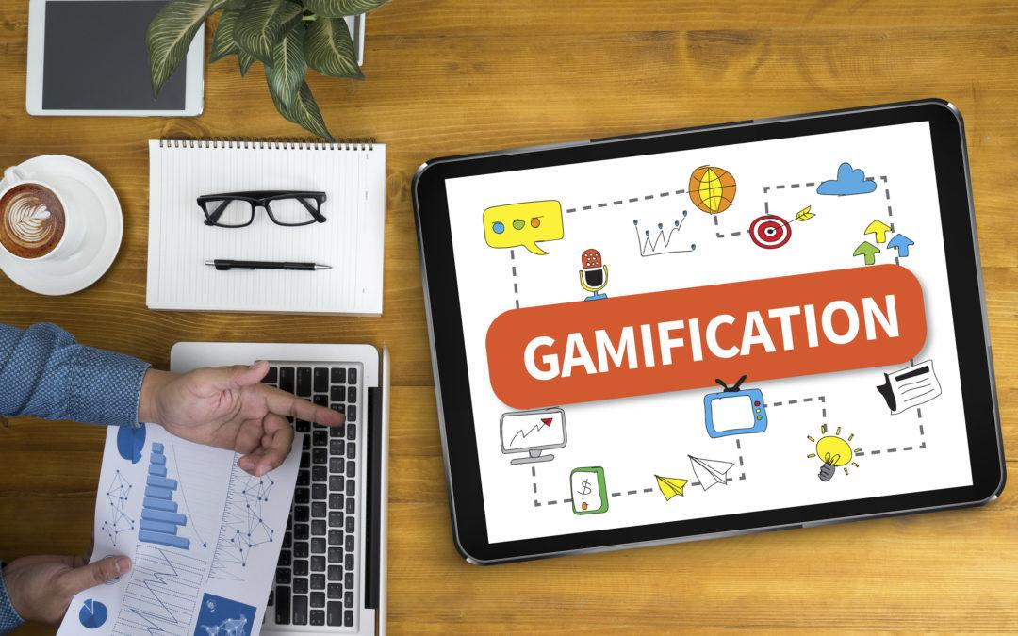
Gamification
“Application of all the fun and addicting elements found in games and applying them to real-world or productive activities”
Notes:
Why is Gamification so important today? Why do we hear this word so much? Well… it’s because the world is more or less digital – this allows us to remove the physical barriers that were there as early as 10 years ago. And Because of the Smartphone revolution, IoT (Internet of Things, and broadband mobile internet have made interactions and transactions so much quicker and seamless than ever before. We’re really living in a global society where we need to be more engaging than ever before – and this is the reason why we have gamification

Slide 5

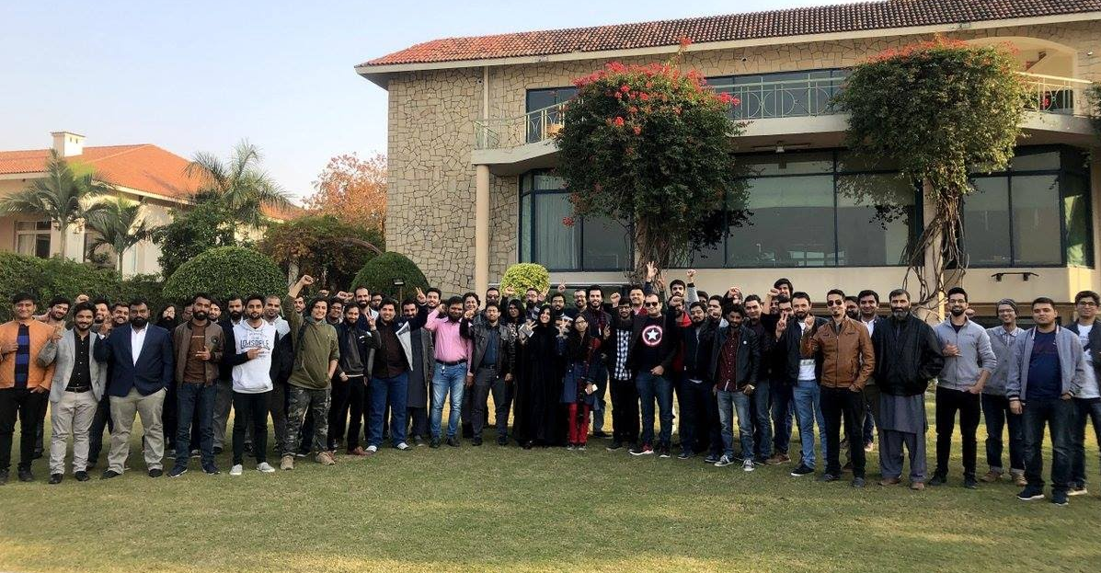
Some Context
Game Development as a Career in Pakistan
Notes:
130 people Free workshop from IGDA Pakistan
Participants from 12 companies and out of the entire audience only 4 were students
Pakistani Game Developers flew in talk from companies such as EA/Apple and Troll VFX
Talks from Industry veterans with 15 years of experience
Paid for by 7 major companies in Islamabad
Endorsed by PSEB and PASHA
With Code For Pakistan and IGDA International

Slide 6
Digital Audience
Apps and Games are used to collect data about usage behavior and demographics
5 Billion people are Digitally Connected and Gamified!
3 Billion people are playing games
5.42 Million hours
logged weekly by users playing games,
using social media
and apps
2.5 billion Social Media users

Slide 7
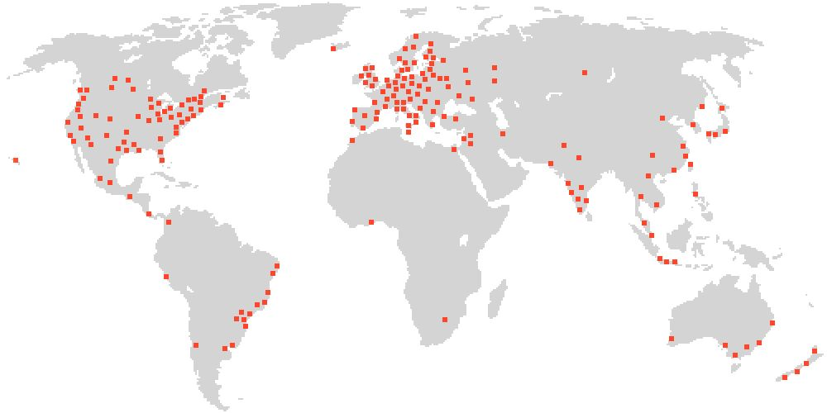
Game Developers Worldwide
Notes:
http://gamedevmap.com/

Slide 8
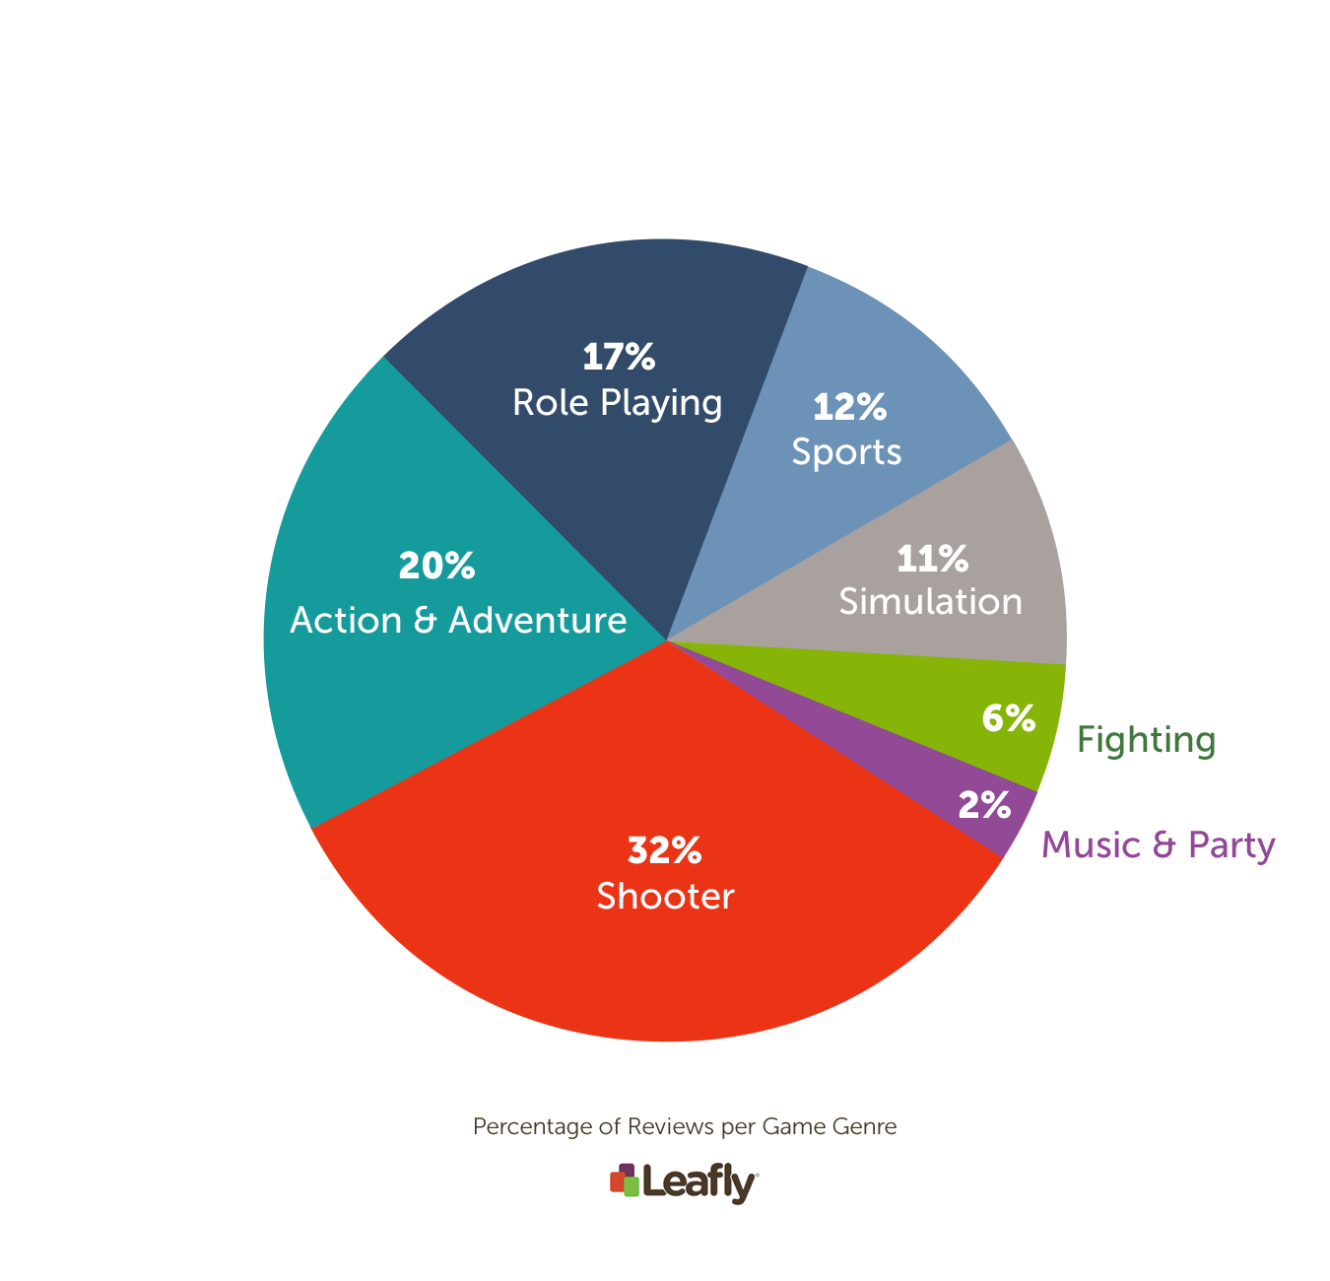
Genres

Slide 9

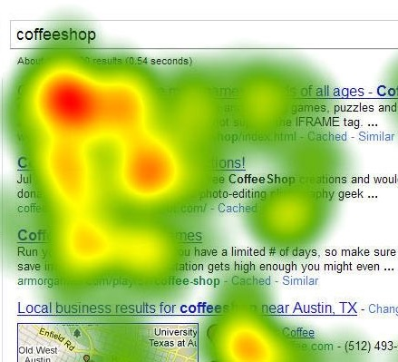

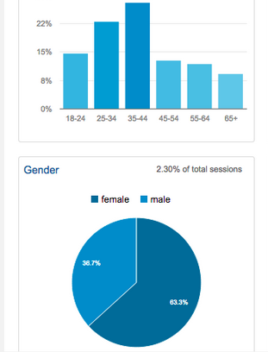
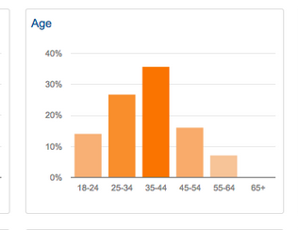
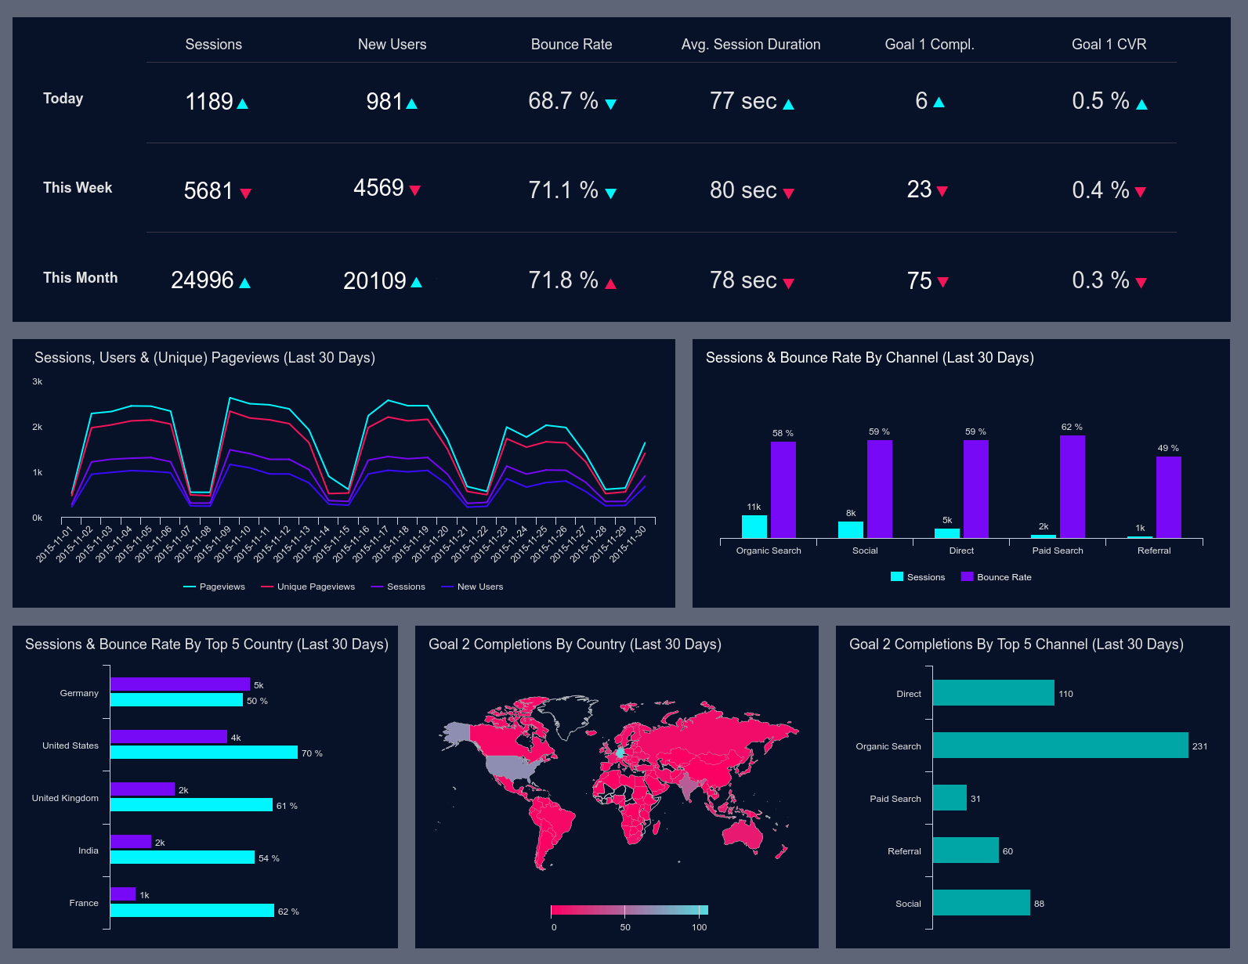
Analytics
Games, Apps and Other Digital Media are data collectors
Demographics
Goal Hunting/ Fiero
Usage
Rest
Behavior
Technical
Notes:
These tools allow us to build better relationships with the product makers and the end user (consumer)
Demographics (age, gender, location, orientation)
Usage (User Interaction between the Application such as how long they use it)
Behavior (Favorite Areas, Interaction Points, Reaction)
Goal Hunting/Fiero (Targeted and Focussed behavior measurement
Rest (the amount of time between sessions)
Technical (App Usage, Crashes, Types of Phones they are using – which can help us understand spending parity)

Slide 10
What is Gamification
Making the Real World Fun and Engaging
FUN & ADDICTING ELEMENTS
Combining them to real-world or productive activities
Notes:
It’s crazy to realize how how connected we all are. Just through technology we can unify and engage with each other like never before. I could give you this talk about how digital makes everything better but it creates a new set of challenges. It’s that of engagement. Gamification, basically solves that. When people show me a design thinking workshop, we in the game development world sort of humor them because design thinking is literally a part of the gamification process.

Slide 11
What is Gamification
Making the Real World Fun and Engaging
HUMAN FOCUSSED DESIGN
As opposed to the “Function-Focused Design”
FUN & ADDICTING ELEMENTS
Combining them to real-world or productive activities.
Notes:
It’s crazy to realize how how connected we all are. Just through technology we can unify and engage with each other like never before. I could give you this talk about how digital makes everything better but it creates a new set of challenges. It’s that of engagement. Gamification, basically solves that. When people show me a design thinking workshop, we in the game development world sort of humor them because design thinking is literally a part of the gamification process.

Slide 12
What is Gamification
Making the Real World Fun and Engaging
HUMAN FOCUSSED DESIGN
PEOPLE DRIVEN
Optimizes for the human in the system, as opposed to pure efficiency of the system
As opposed to the “Function-Focused Design”
FUN & ADDICTING ELEMENTS
All important and stats on one screen.
Notes:
It’s crazy to realize how how connected we all are. Just through technology we can unify and engage with each other like never before. I could give you this talk about how digital makes everything better but it creates a new set of challenges. It’s that of engagement. Gamification, basically solves that. When people show me a design thinking workshop, we in the game development world sort of humor them because design thinking is literally a part of the gamification process.

Slide 13

Why Gamification?
We’ve been using Games for a long time now and never realized it
PROBLEM SOLVING TOOLS
PART OF LEARNING
Identify Problems and show the player how to solve them.
Helped us evolve everything from Communities to Language!
SYSTEM OF INEFFICIENCIES
CONTROLLED ENVIRONMENTS
Games are environments that highlight inefficiencies and a give us a path as to how to solve them
Operate under their own set of rules in which the user can be engaged
Notes:
Cavemen taught their sons to hunt by not giving them real weapons but made a game to improve throwing by tossing rocks at a target.

Slide 14
Solving Problems with Gamification
Participation, Fun Failing, Incentives and Work Fun
Increase in Participation
Failing is a fun activity
Milestones incentivize learning complex topics
What is laborious is fun

Slide 15
Solving Problems with Gamification
Participation, Fun Failing, Incentives and Work Fun
Increase in Participation
Failing is a fun activity
Milestones incentivize learning complex topics
What is laborious is fun
Notes:
Games like elements increases participation
Failing is a fun activity and encourages players to try again
meaning)
Milestones and Incentives allow the user learn and master complex topics
What appears to be a chore is actually fun and engaging

Slide 16
Solving Problems with Gamification
Participation, Fun Failing, Incentives and Work Fun
Increase in Participation
Failing is a fun activity
Milestones incentivize learning complex topics
What is laborious is fun

Slide 17
Solving Problems with Gamification
Participation, Fun Failing, Incentives and Work Fun
PROBLEM SOLVED!
Increase in Participation
Failing is a fun activity
Milestones incentivize learning complex topics
What is laborious is fun

Slide 18



Human Centric Design
Leveraging Digital Audiences for Innovation
1
2
3
MECHANICS
DYNAMICS
EMOTIONS
Rules & Progression
Player Behavior
Player State of Mind
Notes:
“Games have the amazing ability to keep people engaged for a long time,
build relationships and trust between people,
develop their creative potentials.”

Slide 19
Types of Data (Emotional Touch Points)
IMPATIENCE
EXHILARATION
Timed barriers towards Progression
The idea that you are doing something in a way that no one has done before
01
REVENGE
06
02
ACCOMPLISHMENT
Social Features should always allow one player to show someone the ability to boast over someone else
05
03
A reward like a trophy or an achievement
04
DOMINANCE
JEALOUSY
The feeling that you have mastered something difficult
A Friend has beaten your score and progressing further
Notes:
The other areas that Emotional Touch Points (or Types of Data) that we design our gamified products around are based around these elements. Whatever product you make or choose to design them have to keep these areas in mind. Whether it’s an Instagram campaign or a getting people to visit your coffee shop, think of these things. What you refer to as KPIs or Key Performance Indicators are all based on these touch points or on a combination of them.

Slide 20
Engaging the Player!
Digital Products are Gamified
Through constant practice and repetition, the user is able to master these actions
COMMUNITY
MASTERY
Interactions need to feel autonomous
AUTONOMY
For the user to gain interest, there has to be a meaningful relationship between the user and the action
MEANINGFUL
Notes:
But Most importantly Gamification is basically just this. People love to hawk leaderboards, badges, reward points as such and say ‘their product’ is gamified when half the time it really isn’t. Mainly because it needs all four of these elements to be a complete practice. You noticed earlier that I took a slight jab at Design thinking – but once you framework itself against this, you’ll realize that it’s actually a part of Gamification. Or better yet – Human-Centric Design approach. The only reason we call it gamification is because the Video Game industry figured this out first.

Slide 21
Gamification Examples
Civic Solutions
Although Gamification can be broad, I’m going to show you some real world examples…
HERO BANNER
… Also have some more Candy

Slide 22
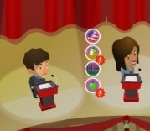
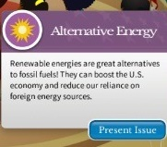
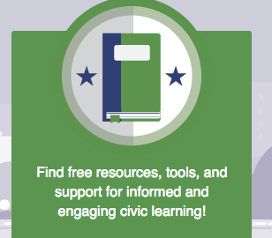
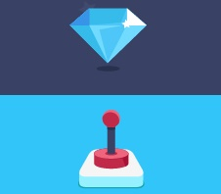
Elections
Gamification platforms for Election Training
Debate
Set Policy
Teaching Resources
Achievements
Students can enter into real-time debates with AI driven bots
Players can set policies to build their campaign around
Teachers have access to a supporting educational pool that will help them assist the players
Players can compete against each other for unique trophies and achievements
Notes:
Debate, Set Policy, Teaching Resources and Achievements

Slide 23
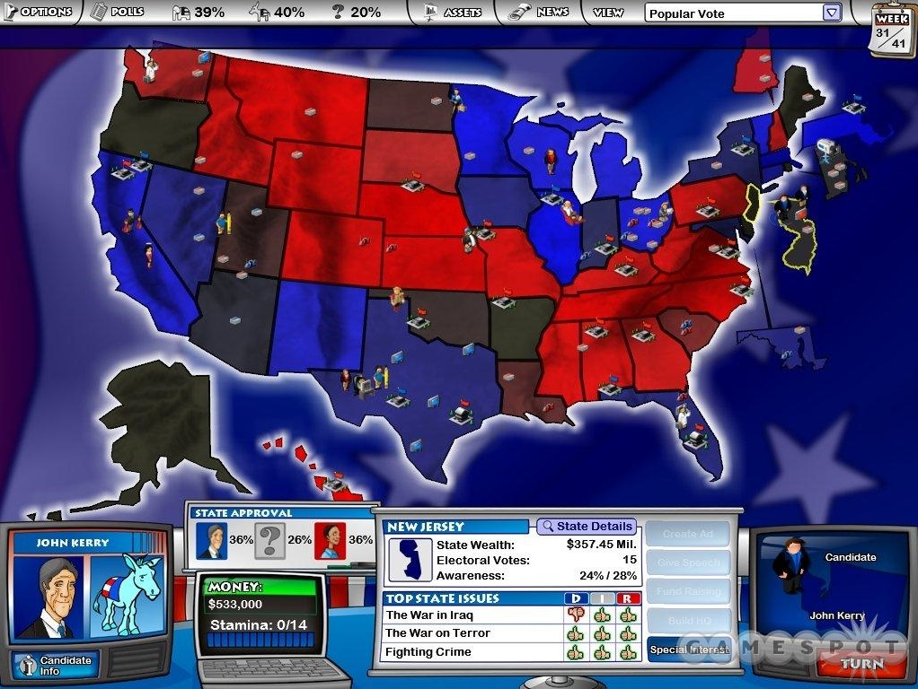
Election Training
Adult and Professional Level
Political Simulations
Advanced games can be created for Adults as well in the sphere of governance, elections and other civic topics using similar gamified components

Slide 24
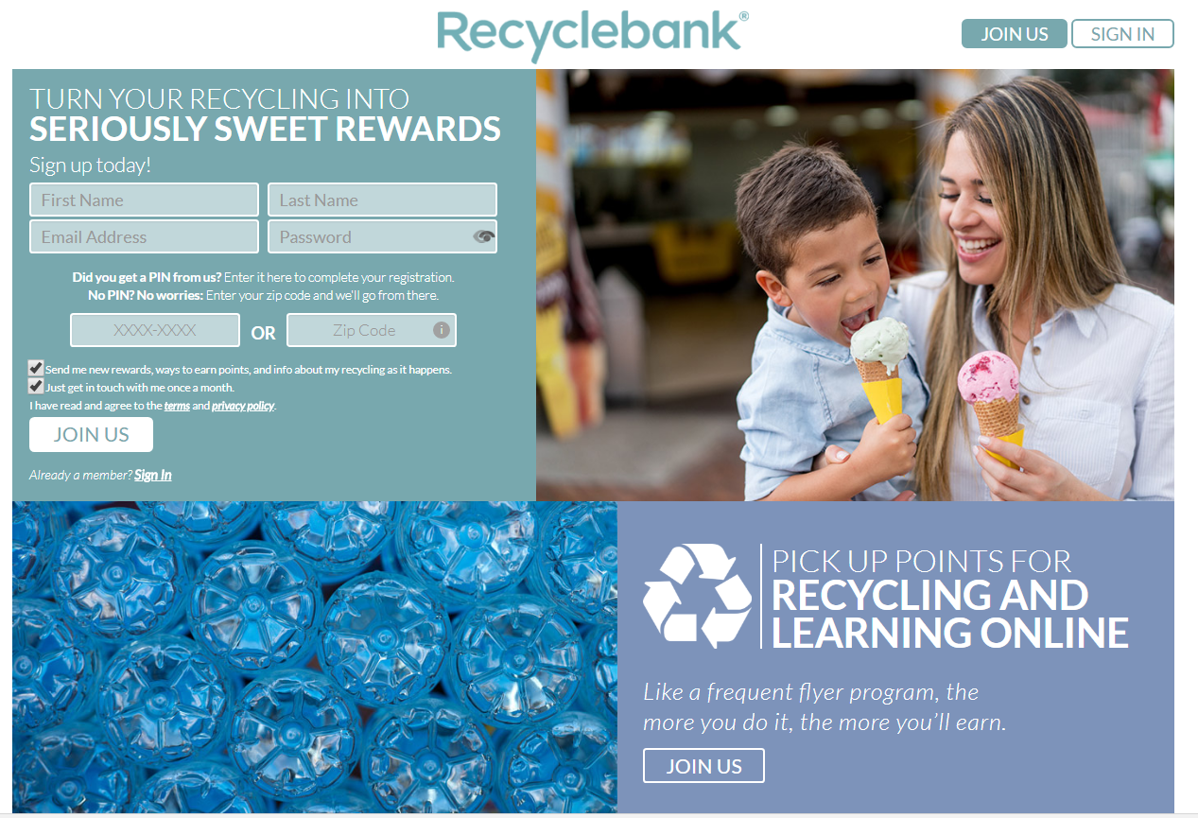
Recycling
Similar Programs have been launched in the EU and Africa
Encourages people to recycle more and reduce landfill trash by awarding points for recycling, saving energy, and answering sustainability quizzes and pledges.
Points are redeemable for actual goods at WalMart, BestBuy and more places, as the city government pays RecycleBank for reducing landfill waste. It now has 3 Million members and over 180 employees pushing the recycling envelope further.
Notes:
Recyclebank – Knowledge Build
Recycling Game in Netherlands for Bus Tokens
Public and Civic Participation

Slide 25
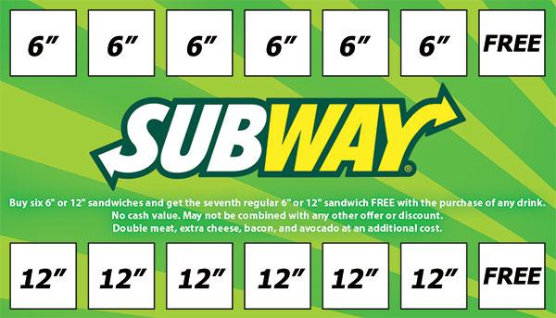
Loyalty Engagement
Repeat Visits
Loyalty Cards
An analog way of gamification is to have loyalty cards. This encourages people to revisit your application, your business, etc by offering a daily reward or a carrot at the end of the stick.
Notes:
Starbucks, Subway, Gloria Jeans all do this to keep you returning by playing this game.

Slide 26
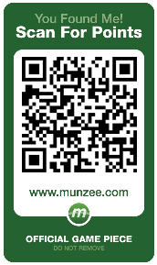

Geocaching
Digital Treasure hunts using Google Maps or even GPS Devices
Geocaching is an outdoor
recreational activity, in which participants use a GPS receiver or mobile device and other
navigational techniques to hide and seek containers, called
"geocaches" or
“caches", at specific locations.

Slide 27
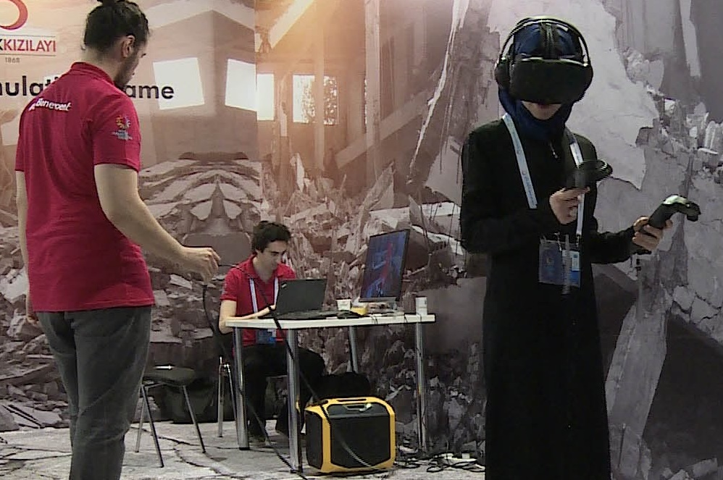
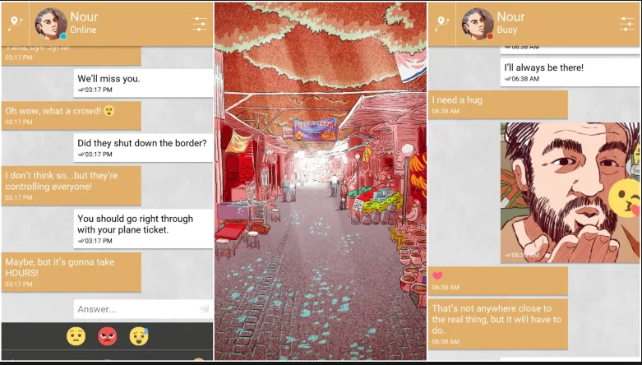
Disaster Games
Immersive simulation of disasters to build empathy and understanding
Disaster VR
Bury Me, My Love

Slide 28
GAME TRIVIA
BUSINESS
TECH
ART
Games have got it all!

Slide 29
What is a Video Game?
Fun & Interactive Experience
Content
Storytelling

Slide 30
Any Questions?

